Slide 1

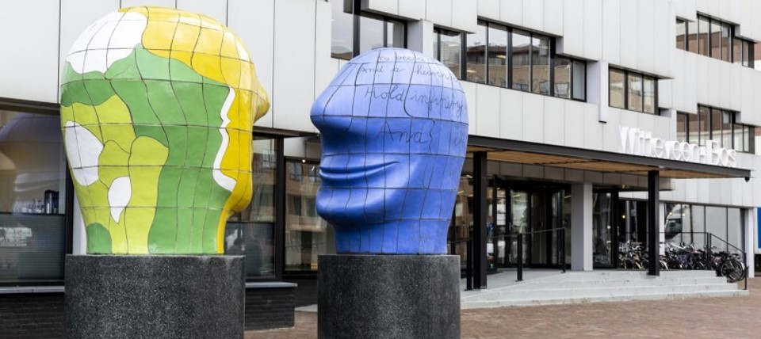
A balanced transition to the new pension plan
Pensioenfondsbestuur –
december 2025

Slide 2
What's on the agenda?
Agreements between management and the Works Council
From agreements to new regulations
What is balanced?
We are converting all pensions
More about compensation
Where are we now?

Slide 3
Agreements on implementation
Start of new pension plan
Appearance:Choice of fixed/variable
Okt/Nov 2026
Eind Q2 2027
Dec ‘25
Nov ‘24
1 jan 2027
1 jan 2028
Initial calculation
Indication of amounts
Second calculation + Pension overview
This is where we are now
Notes:
Gepensioneerden hebben tot 1-1-2028 een variabel pensioen

Slide 4
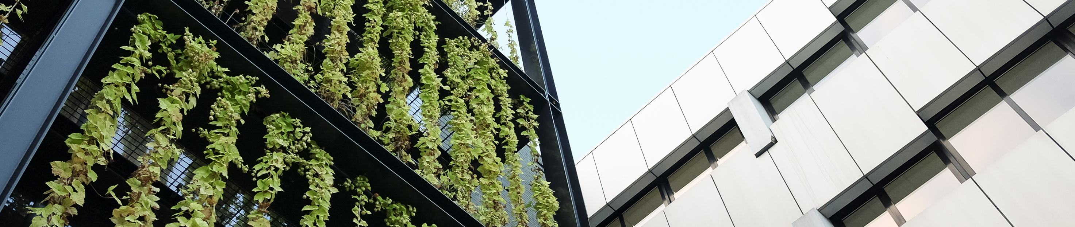
Agreements between management and works council
Notes:
Switch naar sp

Slide 5
The process until December 2024
Agreements by social partners: Witteveen+Bos and the Works Council
Retirees involved via the Witteveen+Bos Retirees Association
Careful consideration has led to a balanced decision

Slide 6
The process until December 2024
agreements have been made by social partners: the works council and Witteveen+Bos;retirees involved via the Witteveen+Bos Retirees Association
careful considerations have led to widely supported decisions

Slide 7
The purpose of the new pension plan
Replacement ratio of 70%, with a lower limit of 60%. This is a target, not a promise!
Solidarity between generations
Keeping the (variable) benefit as stable as possible
Freedom of choice in investment profiles and benefits
Cost neutrality and simple communication
Notes:
Vervangingsratio toelichten:
De pensioenuitkering (plus AOW) gedeeld door de gemiddeld geïndexeerde pensioengrondslag.
De gewogen vervangingsratio kijkt naar de hele periode dat het pensioen wordt uitgekeerd en houdt hierbij rekening met de kans om in leven te zijn.
Voor de berekening wordt de pensioengrondslag ook na pensionering geïndexeerd.
Daarmee wordt het koopkrachtbehoud na pensionering meegenomen in de vervangingsratio.

Slide 8
The new regulation in brief
A more detailed explanation
Roadshow februari 2025
can be found under downloads

Slide 9
The agreements regarding the deposit remain unchanged.
Start contributing from the age of 18.
The contribution amount is aimed at providing an adequate pension:
The target is a net pension (+ state pension): 70% of your average salary
Lower limit = 60%
Contributions
For your pension, 23.66% of the pension base* (the salary that counts towards your pension).
In addition, approximately 4% for insurance.
The employer pays the largest part. You also pay a part.
* The pension base is your ‘pensionable salary’ minus the franchise.
Notes:
Totale premie is en blijft 27,6 %
Indien hier een vraag over komt:
De pensioengrondslag betreft het pensioengevend salaris, verminderd met de franchise. Over de franchise bouw je geen pensioen op.
(Bruto jaarsalaris inclusief vakantie minus het vaste bedrag van de franchise) * parttimepercentage
Franchise is een vast bedrag dat jaarlijks wordt geïndexeerd, 2025 ca. EUR 19.800

Slide 10
New regulation
Current arrangement
Benefit agreement
Agreements about the contribution + the expected pension that you accrue with the contribution
Risks are borne collectively (death, disability, longevity)
The money is invested as a whole
Flexible premium scheme
Agreements about the contribution
You build up capital with the contribution
The capital grows through the return on the investments (which can also be negative)
The capital provides a pension
Risks are borne collectively (death, incapacity for work)
The money is invested for you with a mix that suits your age
Once you retire, the money of everyone who receives a pension is invested as a whole
Notes:
Uitleg over uitkering aan einde presentatie (lang levenrisico, variabiliteit)

Slide 11
Choices
1.The moment your pension commences Choice remains unchanged (no later than age 67)
2.High-low pension or not Choice remains unchanged
3.New Investment method
You can (as long as you are not yet receiving a pension) take more or less risk than the pension fund does for you by default (appropriate to your age).
4.New: Fixed or variable pensionFixed pension: certainty about the amount, no adjustment to price increases.
Variable pension: no certainty about the amount, but the prospect of adjustment to prices.
Notes:
(Deze hebben geen ontwerper-id's aangezien ze zijn gebaseerd op de standaard diamodellen die zich al in de prestatie bevinden.)

Slide 12

Fixed or variable pension
When you start your pension, you can choose between:
Variable: via the Witteveen+Bos Pension Fund
Fixed: via a provider of your choice
Notes:
Mondeling 'variabel' duiden. En wat is het antwoord op de vraag: “waarom moeten we een voorlopige keuze maken als je op moment van pensioneren nog kan wisselen?” Of op de vraag: “waarom kun je niet meer switchen als je voor vast hebt gekozen?”
Met een vaste pensioenuitkering weet je van tevoren hoeveel je de rest van uw leven krijgt. Bij een gelijkblijvend pensioen kun je dus naar verwachting elk jaar minder kopen. Oftewel, jouw koopkracht daalt. Met een variabel pensioen is jouw pensioen ieder jaar anders: je pensioen kan stijgen of dalen.
Shoprecht:
Als je een vaste uitkering wil, bepaal je zelf via welke aanbieder je pensioenkapitaal laat uitkeren. Je vraagt dan 1 of meerdere offertes op bij verzekeraars / ppi’s op basis waarvan een keuze kan worden gemaakt.
Het pensioenkapitaal wordt dan overgeheveld van PFWB naar de andere aanbieder

Slide 13
New arrangement
Current arrangement
You build up the benefit for your partner.
What if you die while you are still working?
70% of the pension you would have received if you had not died + an additional amount until you reach the state pension age
Partially insured
Once retired: 70% of your pension as standard
Orphan's pension: 14% of the pension if you had not died (up to age 25)
Leaving employment?Then the insurance will stop. The portion you have accrued will remain in place
A fully insured survivor's pension.
If you die while still employed?
28% of your final pensionable salary + a fixed amount (EUR 17,000) until you reach the state pension age
Once you retire: 70% of your pension as standard
Orphan's pension: 10% of last pensionable salary (up to age 25)
Leaving employment?The insurance will continue for 3 months. After that, you can continue to be insured. You pay the premium yourself (from the capital you have accumulated)
Notes:
Schets aan de hand van voorbeeld of het naar verwachting meer of minder PP/WP is in nieuwe regeling.
Leggen we meer in detail uit in een komende nieuwsbrief. Daarnaast is het goed om te stellen dat het totale bedrag aan nieuw NP zo goed als mogelijk bij het oude NP blijft, en dat dat m.b.v. maatmensen is onderzocht.
Toelichten bij nabestaandenpensioen: Bij pensionering is er de keuze om pensioen voor je partner om te zetten naar ouderdomspensioen (is nu ook mogelijk)
PP: Het is nu een combinatie van opbouw + een verzekering. Die verzekering vult het partnerpensioen aan als je overlijdt terwijl je nog opbouwt. Straks is het alleen een verzekering.

Slide 14
All payments from the W+B Pension Fund will soon be ‘variable’.
Everyone who receives benefits has pension capital (‘under the hood’)
This capital is invested collectively
The amount of the benefit is determined each year
You will then receive information about the benefit
You will always receive a pension for as long as you live
Notes:
Houdt rekening met dat er een vraag kan komen over demping. Reden dat uitkering is onderlijnd: Het is onderstreept om te benadrukken dat we pensioengerechtigden over schommelingen: dan aangeven dat er een spreidingsmethode wordt toegepast waardoor schommelingen worden niet gaan ‘lastig vallen’ met dat kapitaal. Verder maakt het alleen onrustig en het is vooral een achterkant-verhaal en om aan te geven dat ze geen informatie gaan krijgen over dat kapitaal. Deze sheet bevat informatie voor pensioengerechtigden. Het is dus geen inschatting, maar de daadwerkelijke uitkering.
Uitleg van collectieve uitkeringsfase is ingewikkeld en kan veel vragen oproepen. Basis is dat het kapitaal collectief wordt belegd en risico samen worden gedeeld inclusief het langlevenrisico
Hoe gaan we dat verder regelen (dit staat op een extra slide voor het geval er vragen komen / tijd over is)
- Beleggingrisico en langlevenrisico worden gedeeld door het collectief
- Geleidelijke ingroei in uitkeringscollectief 10 jaar voor pensioen
- Uitkeringen voor alle gepensioneerden gaan jaarlijks even veel omhoog/omlaag (in %)
- Verhogen en verlagen van uitkeringen worden uitgesmeerd over 3 jaar
- Stijging levensverwachting wordt collectief gedragen → verlagen van de uitkeringen, bij dalen levensverwachting andersom – macro langlevenrisico
- Risico dat iemand ouder wordt dan de levensverwachting wordt betaald uit het kapitaal van het collectief (er blijft geld over van mensen die eerder overlijden) – micro langlevenrisico

Slide 15
The benefits collective in brief
Benefit collective
The benefit collective contains the money for the pensions of everyone who receives a pension
Everyone in the collective shares the risks and consequences of changes in life expectancy with each other
The pension fund invests the money in the collective
Key features
Key features
From the age of 57 you gradually join the benefit collective
The pensions of everyone in the collective increase or decrease by the same amount (in %). There is no distinction based on age
We spread each increase or decrease over three years
This agreement expires; you do not have to make a choice 10 years before your retirement.
Notes:
Macro lang leven
Stijging/daling levensverwachting wordt collectief gedragen (uitkeringen gaan omlaag / omhoog), bij dalen levensverwachting andersom
Micro lang leven
Risico dat iemand ouder wordt dan de levensverwachting wordt betaald uit het kapitaal van het collectief (er blijft geld over van mensen die eerder overlijden)

Slide 16
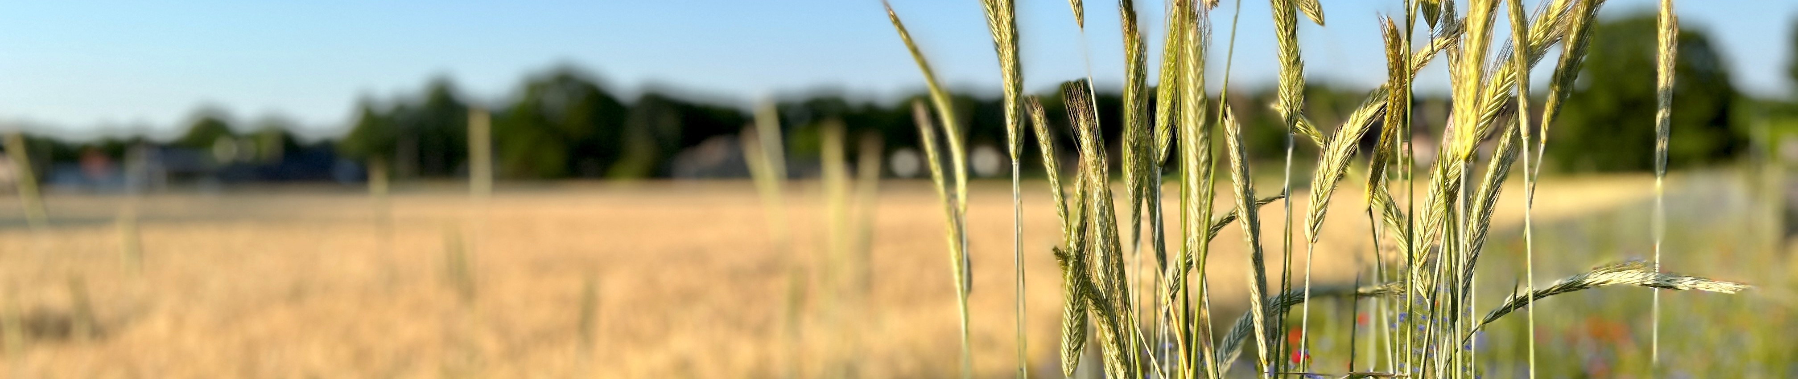
From agreements to new arrangements
Notes:
Switch naar sp

Slide 17
Agreements on implementation
Start of new pension plan
Appearance:Choice of fixed/variable
Okt/Nov 2026
End Q2 2027
Dec ‘25
Nov ‘24
1 jan 2027
1 jan 2028
Initial calculationIndication of amounts
Second calculation + Pension overview
Here we are now
Notes:
Gepensioneerden hebben tot 1-1-2028 een variabel pensioen

Slide 18
What did the fund do last year?
Calculate, calculate, and calculate some more!
Assess feasibility
Schrappen keuze bij 57 jaar vast/variabel
Test balance
Focus on compensation and distribution of assets

Slide 19
What needs to be arranged when switching providers?
Terminate the current pension plan
Convert accrued pensions
Compensation
Distribute remaining fund assets
The transition must be balanced

Slide 20
What needs to be arranged when switching?
The current pension plan must be terminated and the accrued pensions converted
The remaining fund assets (after allocating the value of the pension) must be distributed as evenly as possible
The transition must not favor or disadvantage certain groups

Slide 21
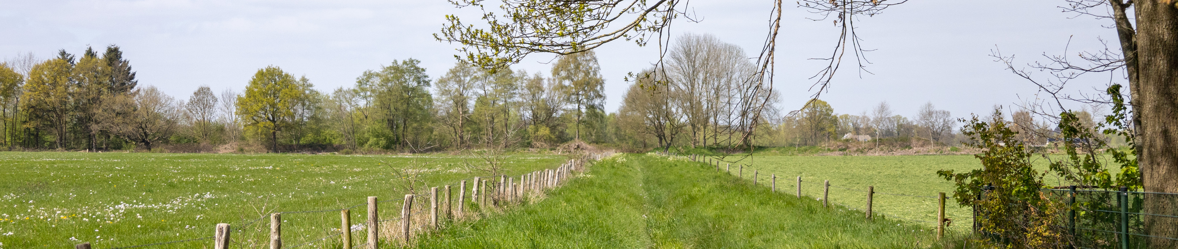
What does “balanced” mean?
Notes:
Switch naar sp

Slide 22
What is balanced?
You can look at the present: what does everyone “have” and will that remain intact? Or are there groups that are losing something?
A second possibility: look at the past. Are there issues that still need to be ‘rectified’?
Look to the future: what is the expected effect of the changes and will they turn out more or less the same?
who is best placed to cope with a setback and who is not?

Slide 23
What is balanced?
You can look at the present: what does everyone “have” and will that remain intact? Or are there groups that will lose something?
...
Look to the future: what is the expected effect of the changes and will they turn out more or less the same?
Methods 1 and 3 are legally required

Slide 24
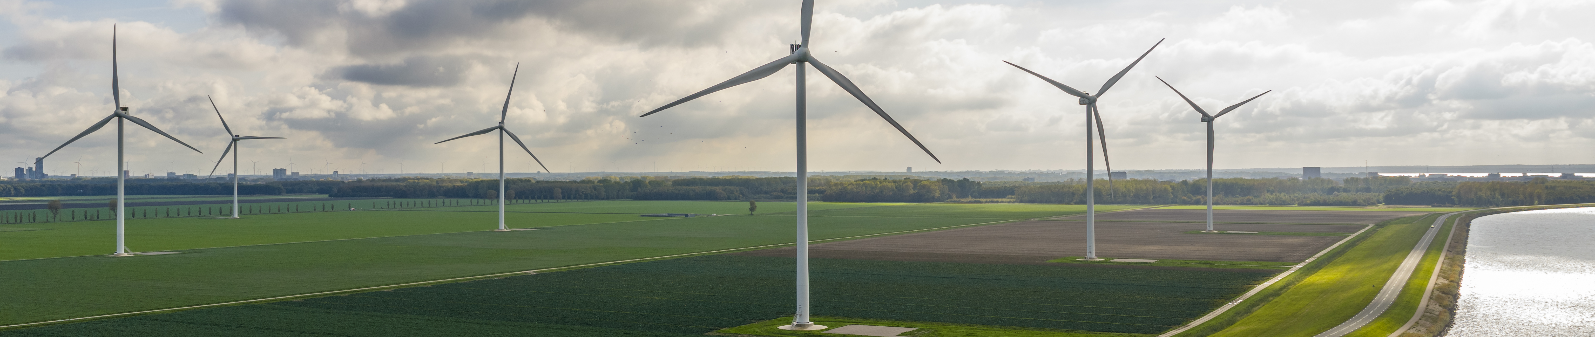
Two criteria for assessing balance (with an eye on the present and an eye on the future)
Notes:
Switch naar sp

Slide 25
First criterion: Payout ratio
What is the weighted average benefit in the current and new pension schemes?
Broken down by age;
Takes into account expected increases and decreases;
Helps to assess whether agreements are balanced;
Example:
The average benefit for a 45-year-old in the current scheme is €100
In the new pension scheme, it is €136
The pay-out ratio is then 136%

Slide 26
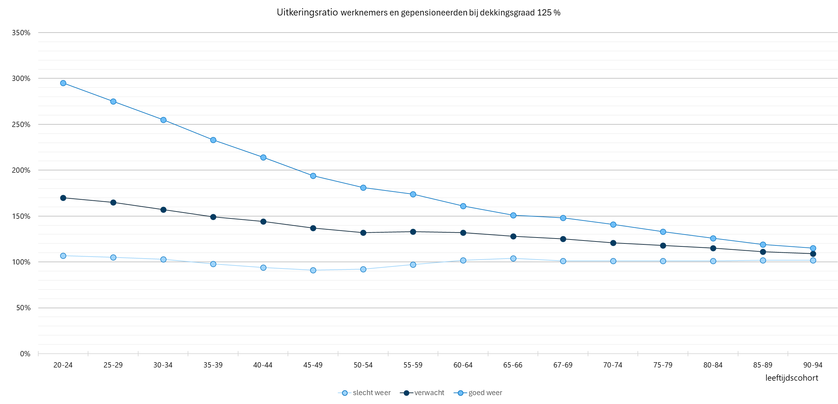
#hier grafiek met uitkeringsratio’s uit laatste ppt AON

Slide 27
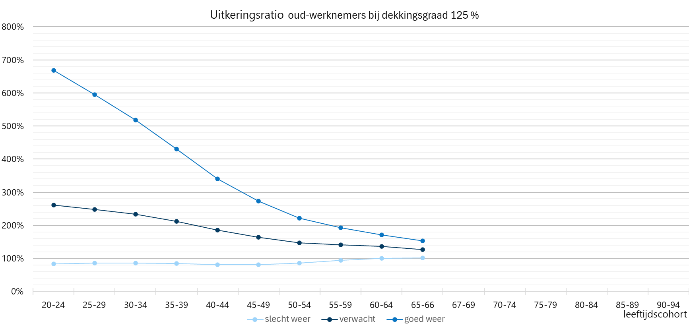
#hier grafiek met uitkeringsratio’s uit laatste ppt AON

Slide 28
Second criterion: Net profit
Does anyone benefit or suffer from the switch to the new pension scheme?
Total (market value) expected benefits -/- total contributions
Before and after the switch
Based on your age (what has already been accrued and what is still ‘to come’?)
DNB attaches great importance to this instrument
We consider the payout ratio to be particularly important

Slide 29
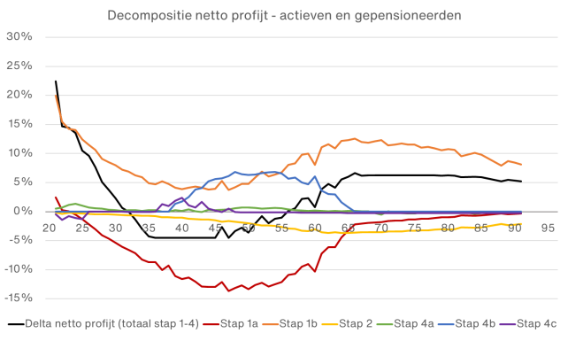
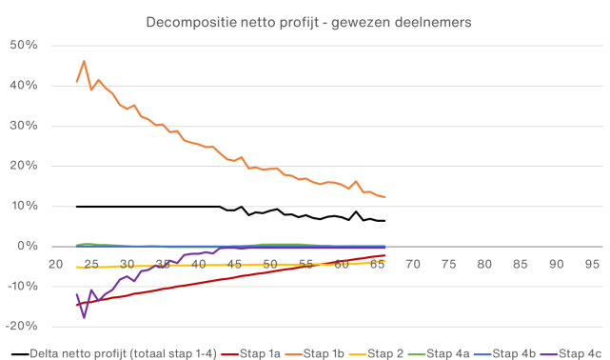

Slide 30
Balanced transition: compensation required
Notes:
Switch naar sp

Slide 31
Why compensation?
Current system:
Young people contribute to the pension fund for older people
New pension scheme
Clear relationship between contributions and returns
Abolition disadvantageous for some.
How much? Depends on financial situation on January 1, 2027

Slide 32
Why compensation?
In the current pension scheme, young people contribute to the pension accrual of older people.
In other words, young people receive relatively little pension and older people receive relatively much pension for their contributions (after all, the money of older people can be invested for a short period of time).
In the new pension scheme, there is a clear relationship between contributions and returns: if you set aside money when you are young, it can be invested for a long time.
The new system is disadvantageous for some. They will receive compensation if possible.
The amount depends on their financial situation on January 1, 2027.
The expected disadvantage will be calculated at that time. (balanced with a view to the future)

Slide 33
Good to know about compensation
Objective: To compensate for the disadvantage of future accrual.
(you would have accrued more under the current pension scheme)
Only if you are employed on December 31, 2026, and January 1, 2027
Will be paid in a lump sum at the start of the new scheme
Amount depends on the coverage ratio on December 31, 2026
Compensation will never exceed the (expected) disadvantage
Coverage ratio too low for compensation?
Consultation between management W+B and Works Council

Slide 34
Good to know about compensation:
Compensation is intended to compensate for the disadvantage of future accrual
(You would have accrued more under the current pension plan).
You must be employed on December 31, 2026, and January 1, 2027, to be eligible for compensation
It will be paid in a lump sum at the start of the new scheme
The exact amount of compensation will depend on the coverage ratio on December 31, 2026
Compensation will never exceed the (expected) disadvantage
If the coverage ratio is too low for compensation, the social partners will enter into negotiations

Slide 35
Good to know about compensation:
Changes in your work situation will result in lower or no compensation
Reference date December 2026:
Termination of employment: no compensation
Retirement: no compensation
Unpaid parental leave: lower compensation
Unpaid leave (100%): no compensation
Part-time work: less compensation
Purchase of vacation days: no impact (one-time exception)
More information in the newsletter and soon on the pension fund website (including calculation examples)

Slide 36
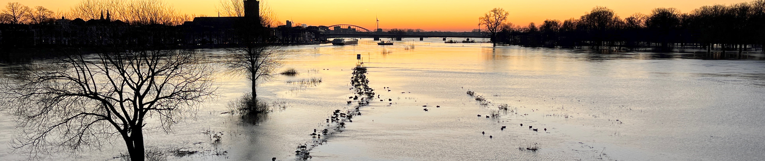
This is how we will achieve a balanced transition (‘phasing in’)
Notes:
Switch naar sp

Slide 37
Converting pensions in a balanced manner
Start-up capital: accrued pension / pension you receive
Mandatory reserve (2%)
Is there any capital left over?
Compensation
Distribution of remaining capital

Slide 38
Converting pensions in a balanced manner
We look at the pension you have accrued or are receiving. That pension has a certain value. (balanced with a view to ‘now’)
In principle, that value is the capital with which you start in the new pension plan.
We look at the size of the fund assets at the time of the transfer. Is there more money than the combined value of all pensions? If so, we distribute the ‘surplus’ capital in accordance with agreements between social partners.
Part of it is (mandatorily) used for an operational reserve
Part of it is used for compensation (balanced with a view to the future)
The rest: a (large) part is used to supplement all starting capital on a pro rata basis (balanced with a view to the present)

Slide 39

What are we talking about?
Conversion of pensions: €220–230 mln
Mandatory buffer: €3–4 mln
Compensation: €8–11 mln
Distribution of remainder: €32–64 mln
With a coverage ratio of 125–145%
Situation at the end of 2026 is decisive

Slide 40
Converting pensions in a balanced manner
We look at the pension you have accrued or are receiving. That pension has a certain value. (balanced with a view to ‘now’)
In principle, that value is the capital with which you start in the new pension plan.
We look at the size of the fund assets at the time of the transfer. Is there more money than the combined value of all pensions? If so, we distribute the ‘surplus’ capital in accordance with agreements between social partners
Part of it is (mandatorily) used for an operational reserve
Part of it is used for compensation (balanced with a view to the future)
The rest: a (large) part is used to supplement all starting capital on a pro rata basis (balanced with a view to the present)

Slide 41
Distributing the remaining money
The board has decided to award these as ‘10 increases’.
The value of these 10 increases in the future will be added to your capital in one lump sum. This is the legal standard.
Everyone will receive an increase that corresponds to how long they are expected to receive a pension.

Slide 42
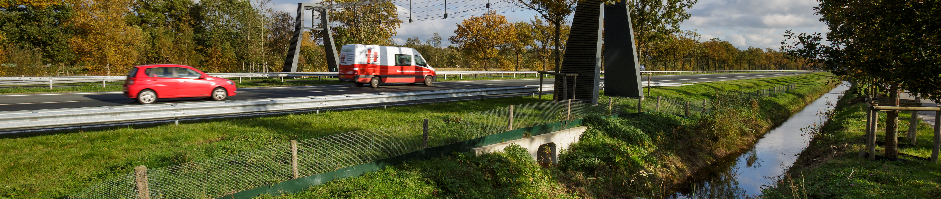
Balanced control: no reserve required
Notes:
Switch naar sp

Slide 43
There will be no reserve.
A reserve is possible in a flexible premium scheme.
Do the pensions being paid out need to be reduced? Then the reserve can be used to supplement the payments.
The Witteveen+Bos pension fund will not be establishing a reserve. Why not?
Although the likelihood of a reduction is smaller, so too is the likelihood of an increase.Other measures are sufficient to prevent major fluctuations.

Slide 44
No reserve
A reserve is possible in FPR
Can be used if pensions to be paid need to be reduced
W+B does not opt for this reserve
Why not? The effect does not outweigh the costs/greater complexity
In addition: other mechanisms work well enough

Slide 45
Frequently heard responses
Notes:
Switch naar sp

Slide 46
“Why don't we leave the current pensions as they are?”
Conversion is the legal standard. Social partners do not deviate from this:
Not converting means maintaining two schemes. This is relatively expensive
Not converting means that investing the remaining money becomes increasingly risky. After all, the group is getting smaller. Spreading risks is becoming increasingly difficult
Converting: better expected return, higher expected pension, lower costs.

Slide 47
“I think it's unfair that someone who has only been with the company for a short time receives compensation, while I have worked for the company for a very long time.”
Someone who has worked for the company for a long time will also have accrued a relatively large pension. We ensure that the value of that pension remains intact.
The remaining assets will be distributed pro rata, so someone with a large pension will also receive more compensation.
The number of years worked does not count.

Slide 48
“Why should young people receive compensation? They have many years ahead of them and can benefit from the new pension scheme.”
That's right. When calculating compensation, we take into account what the new scheme is expected to yield. If there is an expected disadvantage, this should be offset by compensation.
It would be unfair to give a certain age group no compensation or less compensation, so that more money remains to supplement the pensions of another group.

Slide 49
“Why does an 85-year-old receive less money than a 70-year-old when it comes to the distribution of the ‘money that is left over’?
The pension fund calculates using averages, including average life expectancy.
The ‘money left over’ is distributed as if it were ten consecutive indexations (increases). These indexations are then granted in one go. Not everyone is expected to receive all ten indexations.The money belongs to everyone and must be distributed as fairly as possible.

Slide 50
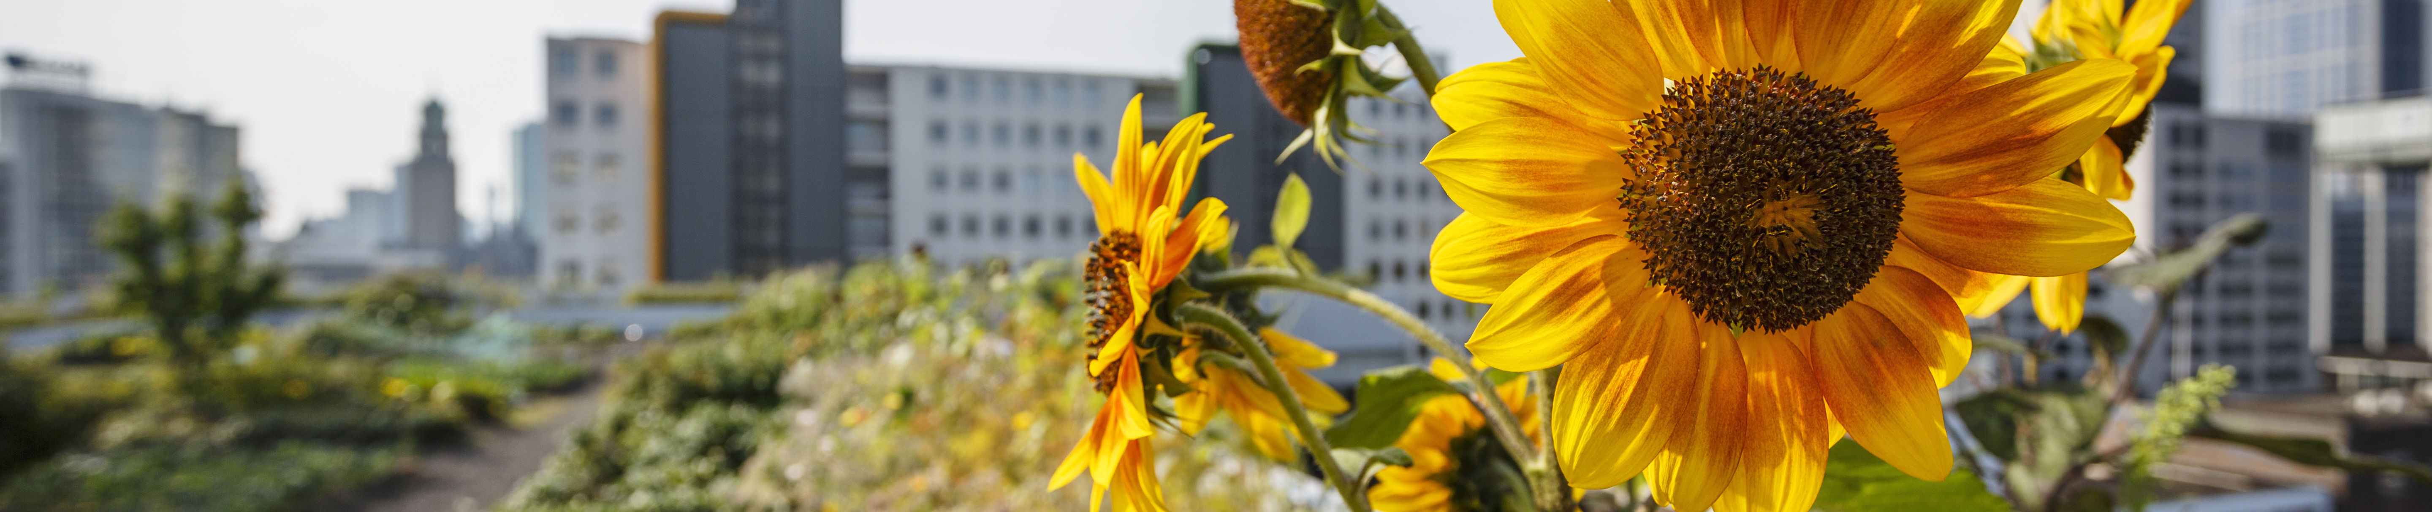
Where are we now?

Slide 51

Agreements on implementation
Start of new pension plan
Appearance:
Choice of fixed/variable
Okt/Nov 2026
End Q2 2027
Nov ‘24
1 jan 2027
1 jan 2028
Initial calculationIndication of amounts
Second calculation + Pension overview
Here we are now
Notes:
Gepensioneerden hebben tot 1-1-2028 een variabel pensioen

Slide 52
Questions?

Slide 53

www.pensioenfondswitteveenbos.nl

